Slide 1

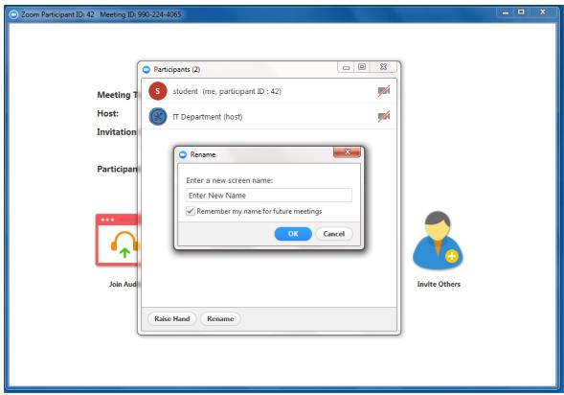
Welcome to the LARC LS #3
Please sign-in in the “Chat Box”, include:
  Your Name
  Organization
  Site/s where you work or coach
  All names of persons at your site
Please rename yourself with your site location code and actual name / facility name

Slide 2
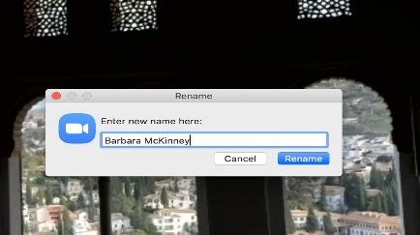
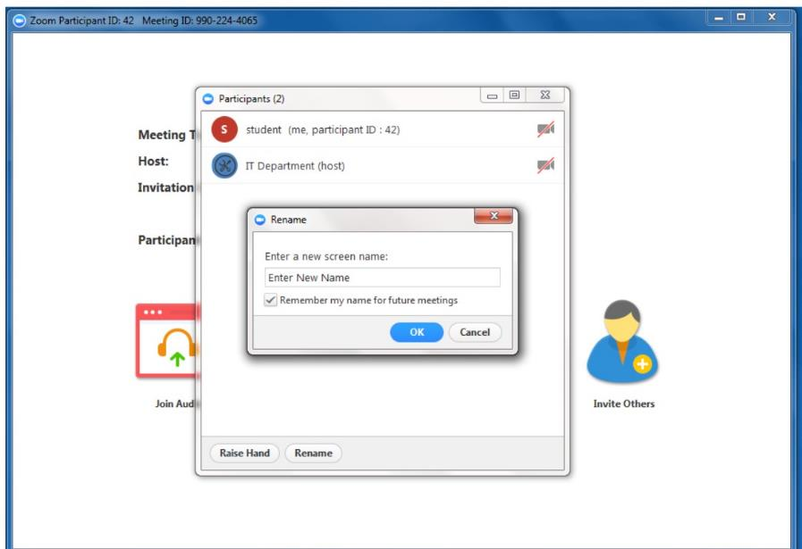
Click on “Participants” at bottom of screen
Rename
Click on your name & Select “Rename”
Rename - Begin with Location Code, then name or facility name, i.e., MBA - Phyllis
Site | Location Code
BRIDH | BRIDH
Budiriro | BUD
Chitungwiza | CHIT
Epworth | EP
Hatcliffe | HC
Hopely | HOP
Kwadzana | KWAD
Mbare | MBA
NMRL | NMRL
Overspill | OS
Pari | PARI
PSI Lab | PSI
Seke North | SN
St. Marys | SM
Zengeza | ZEN

Slide 3


It’s HERE
On a Screen Near You
LS #3 – September 14-16

Slide 4
Welcome

Slide 5
Introductions

Slide 6


Turn on Your Camera
Smile
Wave
Let us see your smiling face

Slide 7


Begin with the End in Mind

Slide 8





Remember: DMAIC
SEPT
/ OCT
By NOV
AUG 5 – Sept 2
DEFINE
MEASURE
ANALYZE
IMPROVE
CONTROL

Slide 9
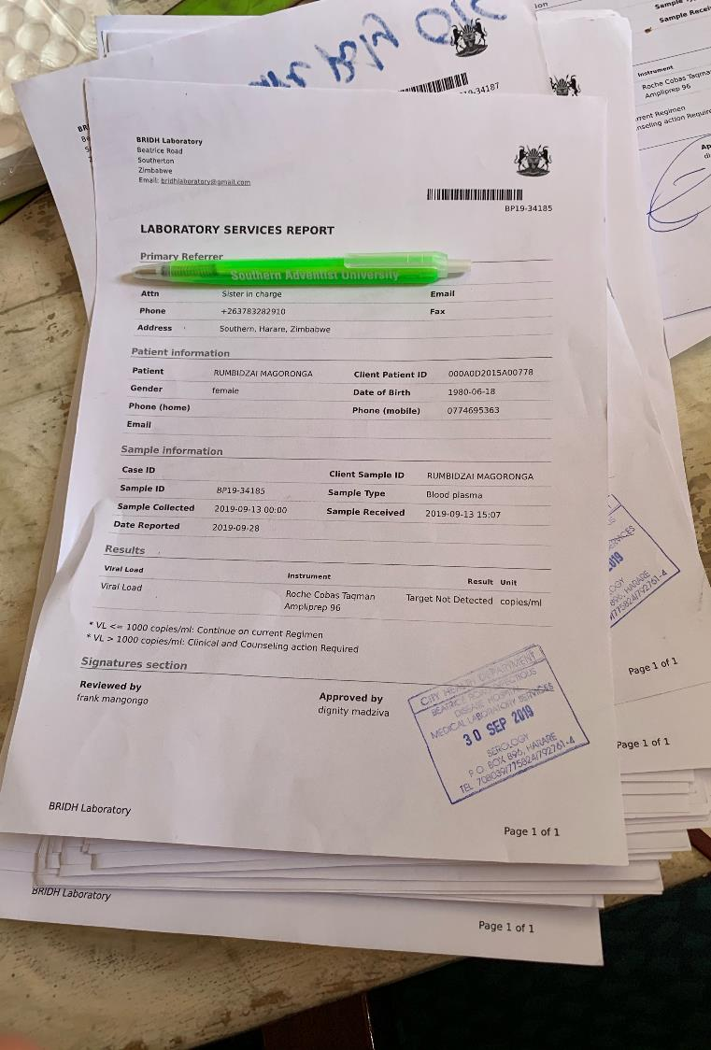
Aim #3: Improve
Viral Load Coverage
Viral Load Test Result

Slide 10
Project Summary
What are we trying to accomplish? | How will we know if a change is an improvement? | What change will we make that will result in an improvement?
Overarching Goal Improve Viral Load Coverage | AIM Statement Increase proportion of Eligible Patients with a Viral Load Test completed* from to by 15 November 2020. * - Results Recorded = # of Viral Load Results recorded in Patient Record # of Patients Eligible for a Viral Load Test | Intervention
10

Slide 11


GOAL:
Be ready to begin testing CHANGES on September 17

Slide 12




Select two (2) CHANGES to test,
based on the 3 inputs:
VOC RCA OFI
Deliverables for LS #3
Detailed PDSA Worksheet for each CHANGE selected
Data Collection Plan

Slide 13
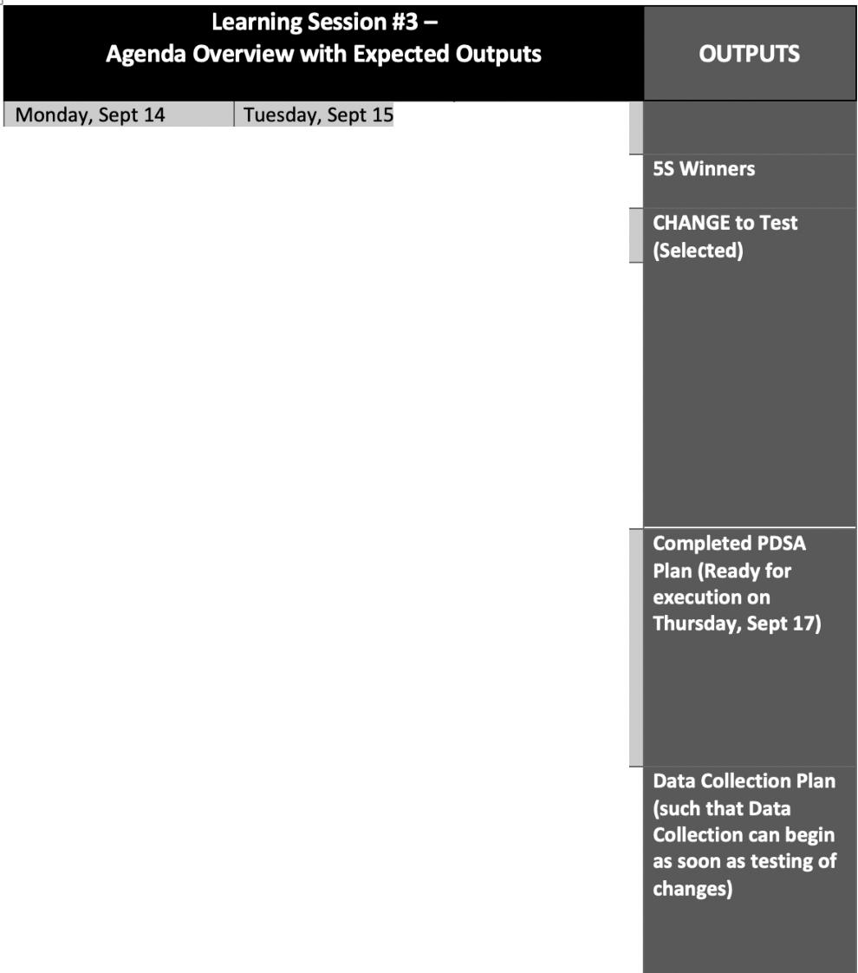






Wednesday, Sept
16
SS Challenge SS Video
Challenges Identified for VL Covera e
Brainstorm Change
Ideas for Aim #3 - based on challenges discussed
Considering 1) OFI*,
2) RCA*, & 3) VOC* Review CHANGE Ideas
Select best CHANGE to test
Introduce PDSA Plan (Didactic)
Complete PDSA Plan for Selected CHANGE
Data Collection Plan
Refine PDSA Plan
Data Collection Exercise
Data Collection Exercise Debrief
Data Collection Plan Presentation
-Q&A/
Clarification
Data Collection Plan
Presentation - Detailed Demonstration

Slide 14


PAGER – Monday, September 14
Purpose:
To provide a guided approach to QI Initiative Aim #3 – Viral Load Coverage
  Define / Measure / Analyze / Improve Phase – CHANGE Menu, CHANGES Tested = PDSA
Agenda:
5S Challenge / 5S Video
Challenges to improving VL Coverage Presented Change Ideas – Brainstorming / Sharing Measurement Exercise
Ground Rules:
Begin & end on time, Respect for all persons & all thoughts, Encourage engagement & participation,
Keep audio on mute unless speaking / Raise hand to share or put question in chat box
Expected Outcomes:
Deliverables:
  CHANGES Selected
  Test CHANGES - PDSA Worksheet
  Data Collection Plan

Slide 15
Project Deliverables
DUE SEPT 2
Define/Measure/ Analyze
DUE SEPT 14
Learning Session 3 Improve
DUE AUG 26
Define/Measure
DUE SEPT 30
Improve / Control
q Process mapping (current, updated COVID) q Problem Statement q Baseline Metric q Presentation | q Voice of the customer q Analyze tools (Fishbone, 5 whys, etc.) q Presentation | q 5 S q Linkage of Identified OFI, VOC, & RCA to CHANGES q Presentation | q CHANGES (2) Tested (PDSA – 2 for each CHANGE) q Data Collection – After Improvement q Presentation

Slide 16
5S Challenge

Slide 17


And the winners are: (Drum Roll, please)
CLINIC: ZENGEZA POLYCLINIC
LAB: PSI VL LAB

Slide 18
Site: ZENGEZA POLYCLINIC
Coach: F. NEHWATI
Team Members: R. MUJATI (OI nurse), Y. MASIKONDO(DEC), T. MLILO(OI Nurse), M. KWARAMBA(PC)

Slide 19
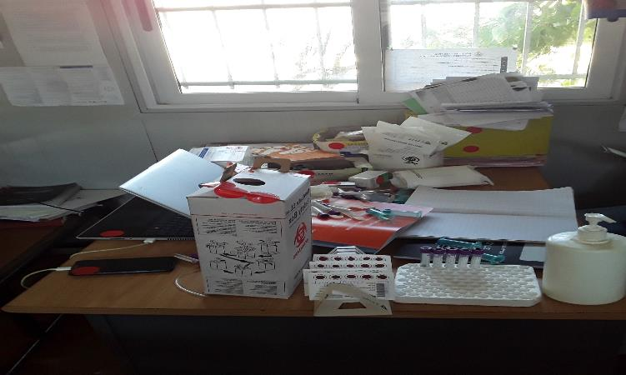
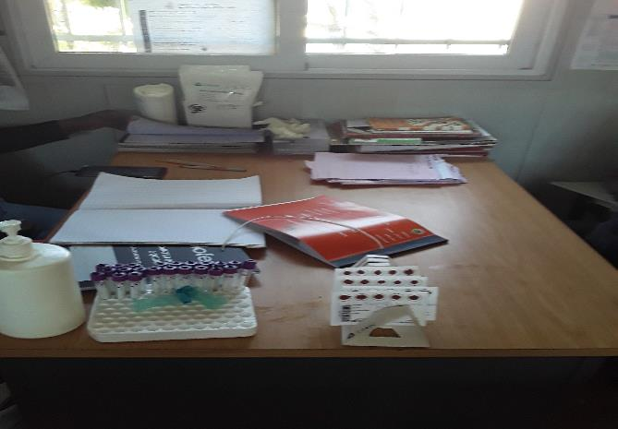
Define
Measure
Analyze
Improve
Control
5S – BEFORE SORT - BEFORE
SORT - AFTER
• Insert Photo
• Insert Photo
19

Slide 20
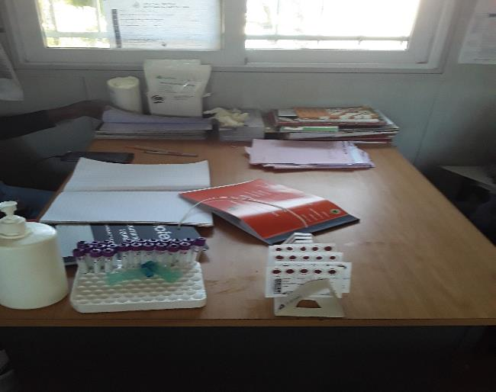
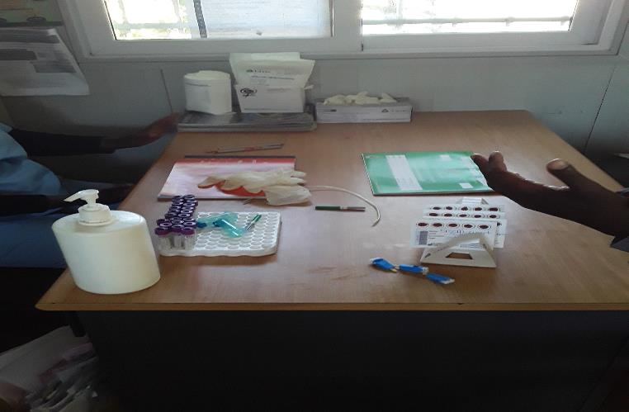
Define
Measure
Analyze
Improve
Control
SET IN ORDER- BEFORE
SET IN ORDER - AFTER

Slide 21
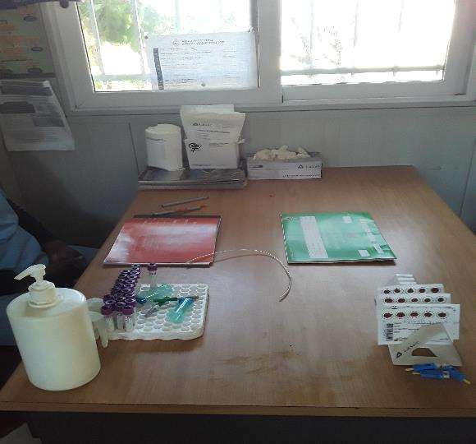
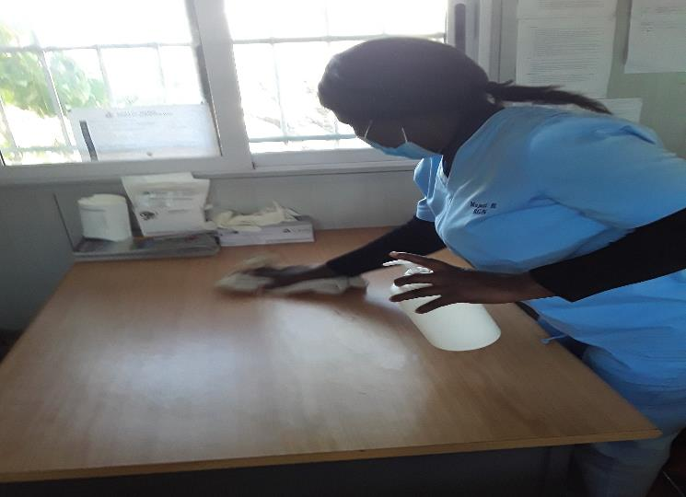
Define
Measure
Analyze
Improve
Control
SHINE - BEFORE
SHINE - AFTER

Slide 22
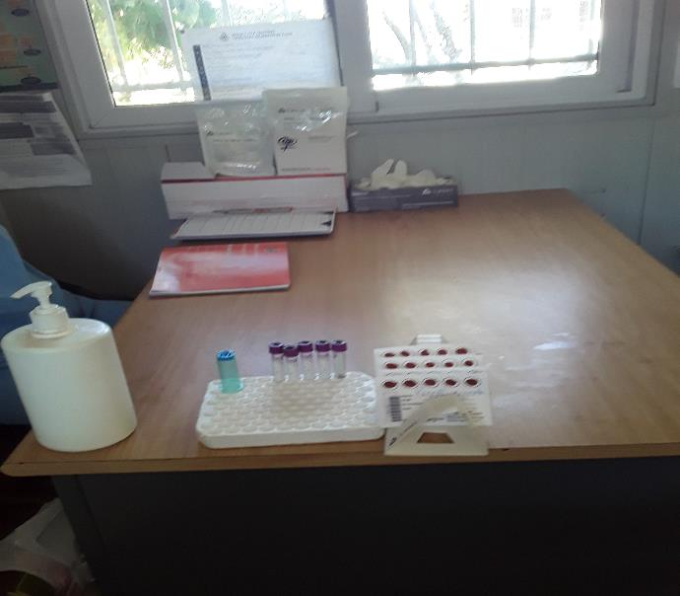
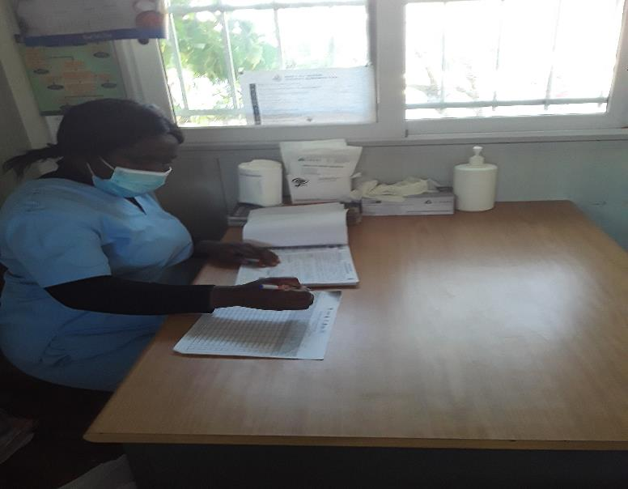
Define
Measure
Analyze
Improve
Control
STANDARDIZE - BEFORE
STANDARDIZE - AFTER

Slide 23
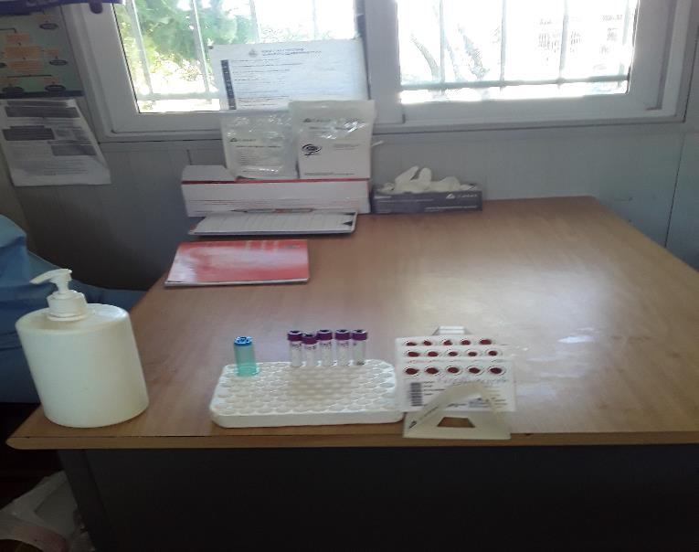

Define
Measure
Analyze
Improve
Control
SUSTAIN - BEFORE
SUSTAIN - AFTER

Slide 24


Define
Measure
Analyze
Improve
Control
AUDIT SCORE 5S - BEFORE
5S - AFTER
AUDIT SCORE
score
20%
100%
80%
60%
40%
20%
0%
15%
10%
5%
0%
Series1
score
sort
shine
sustain
sort
set in order
shine
standardize
sustain
set in order
standardize
24

Slide 25
Site: PSI VL LAB
Coach: Samuel Chisango
Team Members: Chiedza Mguni(Faculty), Collen Kamwanza, Vimbai Mubayiwa, Thomas Ngano, Rufaro Magadu, Lovemore Hweta, Patrick Musa, Life Gumiso, Francis Dodzo

Slide 26
IMPROVE
5S - BEFORE
Audit Score
5S - AFTER
Audit Score
5S AUDIT SCORE
6
5
AUDIT SCORE
4
SORT
SET IN ORDER SHINE
STANDARDIZE
SUSTAIN
3
2
1
0
BEFORE
5S
AFTER
26

Slide 27
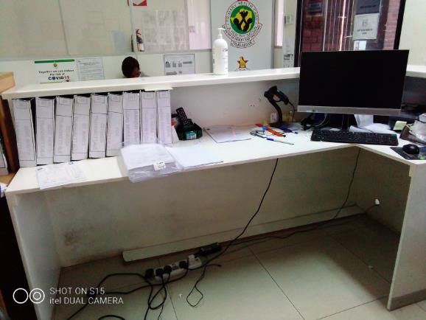
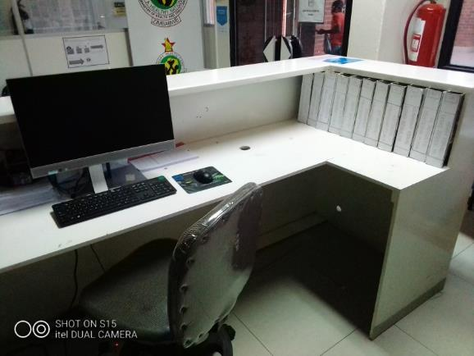
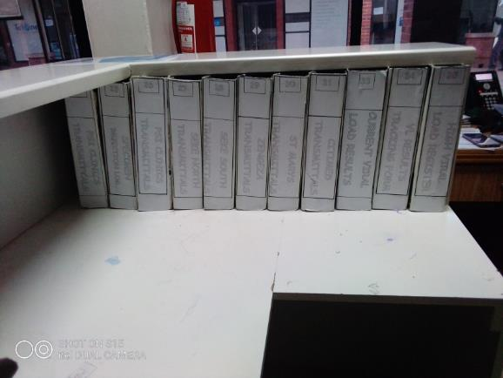
IMPROVE
5S - BEFORE
5S - AFTER
27

Slide 28
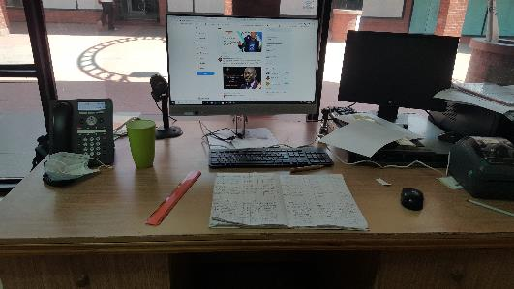
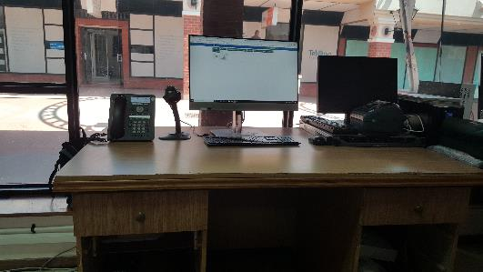
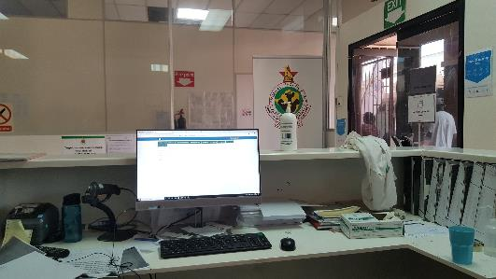
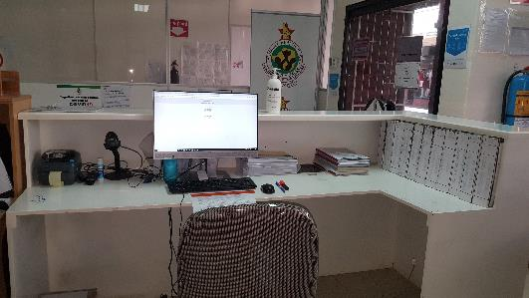
IMPROVE
5S - BEFORE
5S - AFTER
28

Slide 29
IMPROVE
5S - BEFORE
Audit Score
5S - AFTER
Audit Score
5S AUDIT SCORE
6
5
AUDIT SCORE
4
SORT
SET IN ORDER SHINE
STANDARDIZE
SUSTAIN
3
2
1
0
BEFORE
5S
AFTER
29

Slide 30

5S CHALLENGE WINNER
Let it be known that the
Zengeza Polyclinic
Is the Winner of the 5S Challenge in the Clinic Category
Awarded by Barbara McKinney, MD, MPH & Katy Yao, PhD
This 14th day of September 2020

Slide 31
5S CHALLENGE WINNER
Let it be known that the
PSI Viral Load Lab
Is the Winner of the 5S Challenge in the Laboratory Category
Awarded by Barbara McKinney, MD, MPH & Katy Yao, PhD
This 14th day of September 2020

Slide 32
5S Video

Slide 33
Challenges in Improving Viral
Load Coverage

Slide 34
Challenges
Care Not at Primary Clinic Site*
Information Flow – Documentation & filing of medical records
Travel related & lack of funds
Social Distancing
Cohort Forming
Client testing is out of sync with assigned cohort
Identification of VL-Eligible Clients
Given multiple cohorts over many years, no reliable method to identify eligible clients
Appointment System
Duplicate Systems – Diary and electronic systems
Lack of reminders – Pt. forgets
Demand Creation / Client Activation
Lack of client ownership of own health & healthcare
Viral load illiteracy
Clinic Processes
Inefficient clinic processes, Long wait time for clients
Viral Load not drawn at appointment
Stockout
*Due to Community Outreach Testing, Visiting Another Site, and/or Site Closure

Slide 35
CHALLENGES
CHANGE IDEAS*
To Address:
Maintain Health Records
Cohort Assignment or Reassignment
System to ID VL-Eligible Clients
Redesign Appointment System Activate / Educate Clients
Redesign Clinic Processes
Care NOT at Primary Site Cohort Forming
ID of VL-Eligible Clients Appointment System
Demand Creation / Client Activation
Clinic Processes
CHANGES = *Change Ideas = Solutions

Slide 36

Brainstorm CHANGE Ideas
Given the assigned Challenge,
Brainstorm CHANGE Ideas
Facilitator to record CHANGES on the Template
Breakout Room
Outputs:
q List of CHANGE Ideas

Slide 37
Example: CHANGE Ideas
Give some example CHANGE Ideas that would be appropriate to
address the Challenge of Clinic Processes?
Challenge = Clinic Processes

Slide 38
Accept
Accept Zoom Breakout Room Invitation – Click on “Join Breakout Room”
Upon arrival in Breakout Room
Click on Participant List
Unmute your Microphone
Room
Zoom Breakout Rooms
In Breakout Room
Coach to facilitate
Objective: Given an assigned challenge, brainstorm a list of CHANGES.
Record CHANGES on Template
Room
Return
Return to Main Zoom meeting
Coach prepared to share screen with list of CHANGES

Slide 39
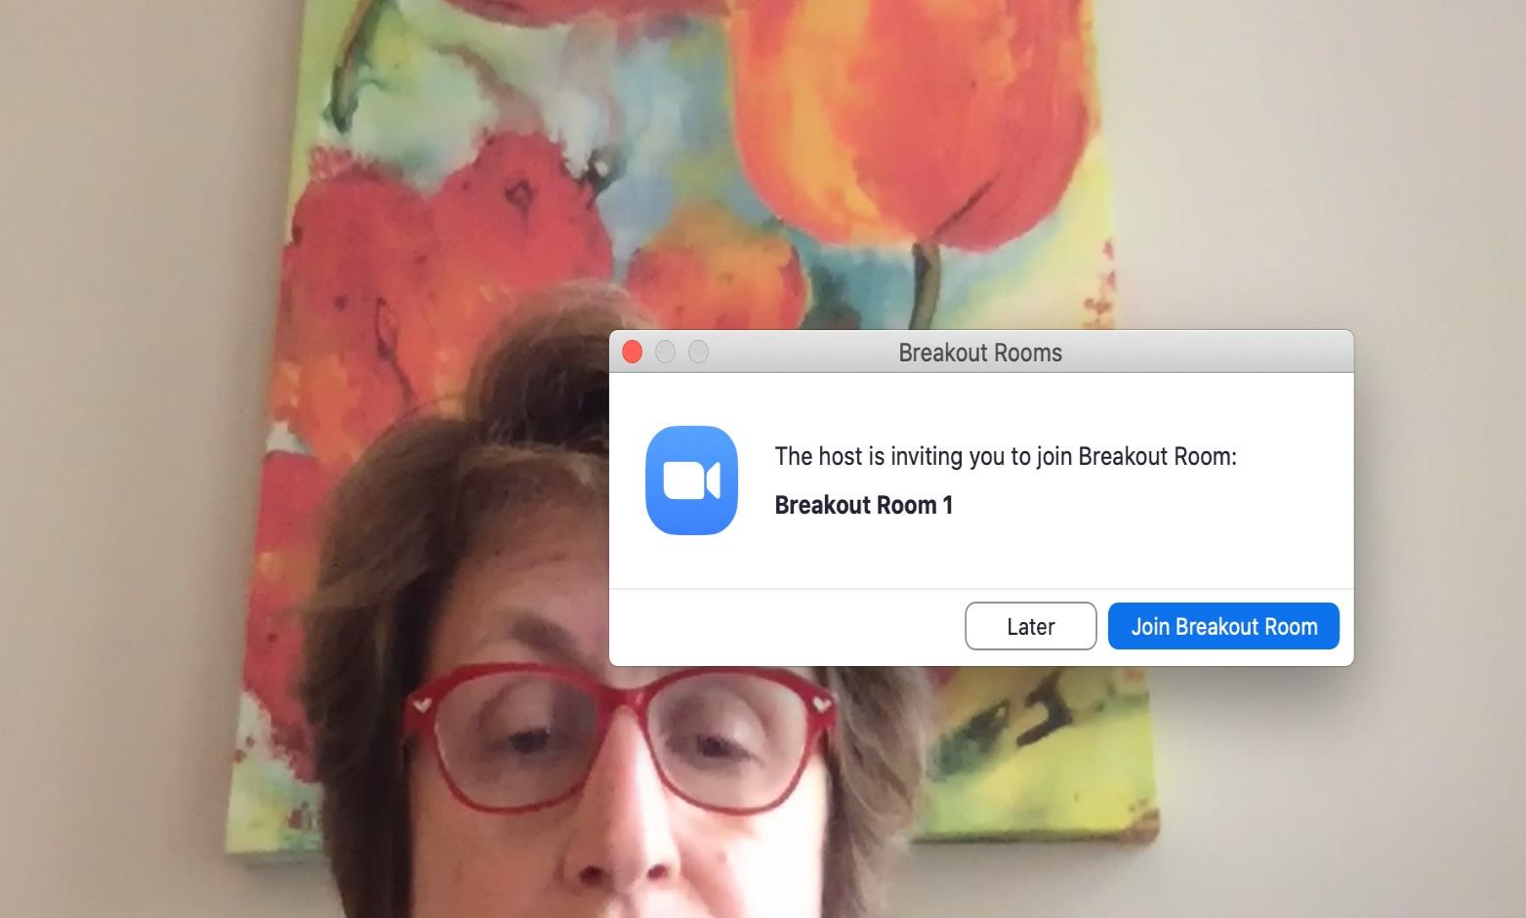
Click Here

Slide 40
CHANGE IDEAS
CHALLENGE

Slide 41
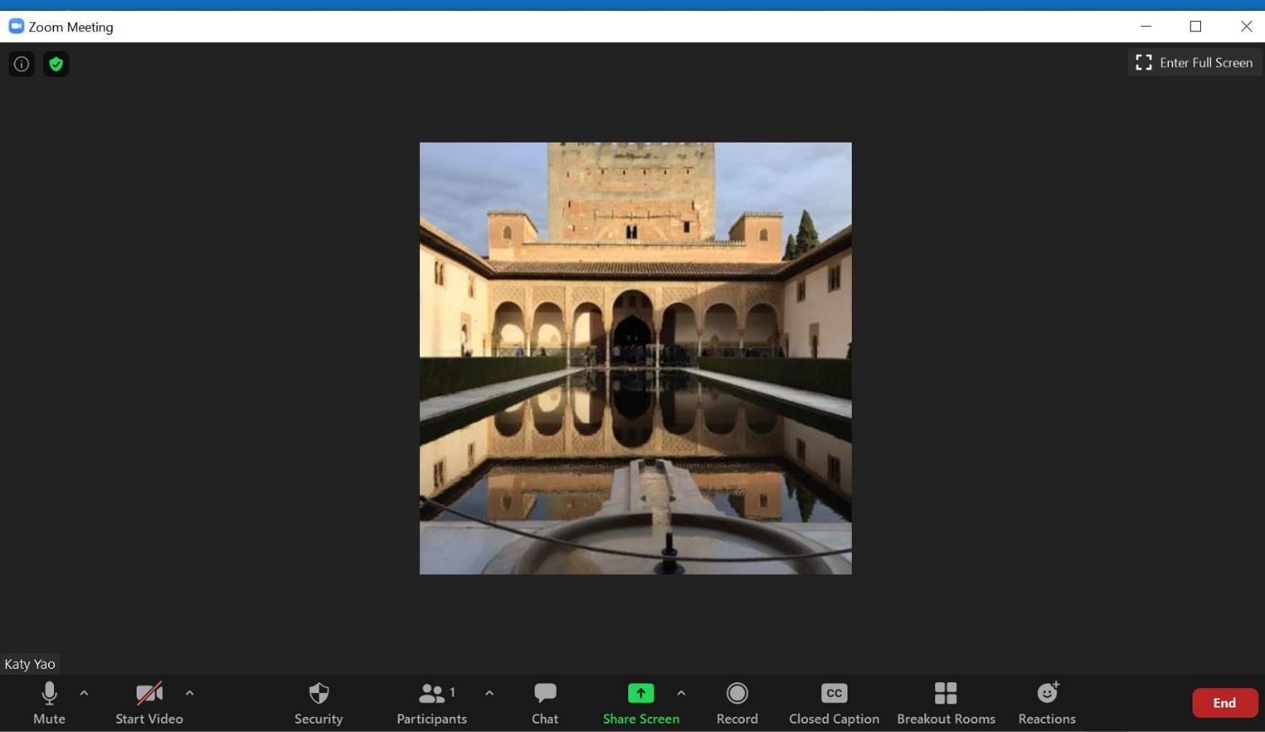
Step 1 – Click Share Screen

Slide 42
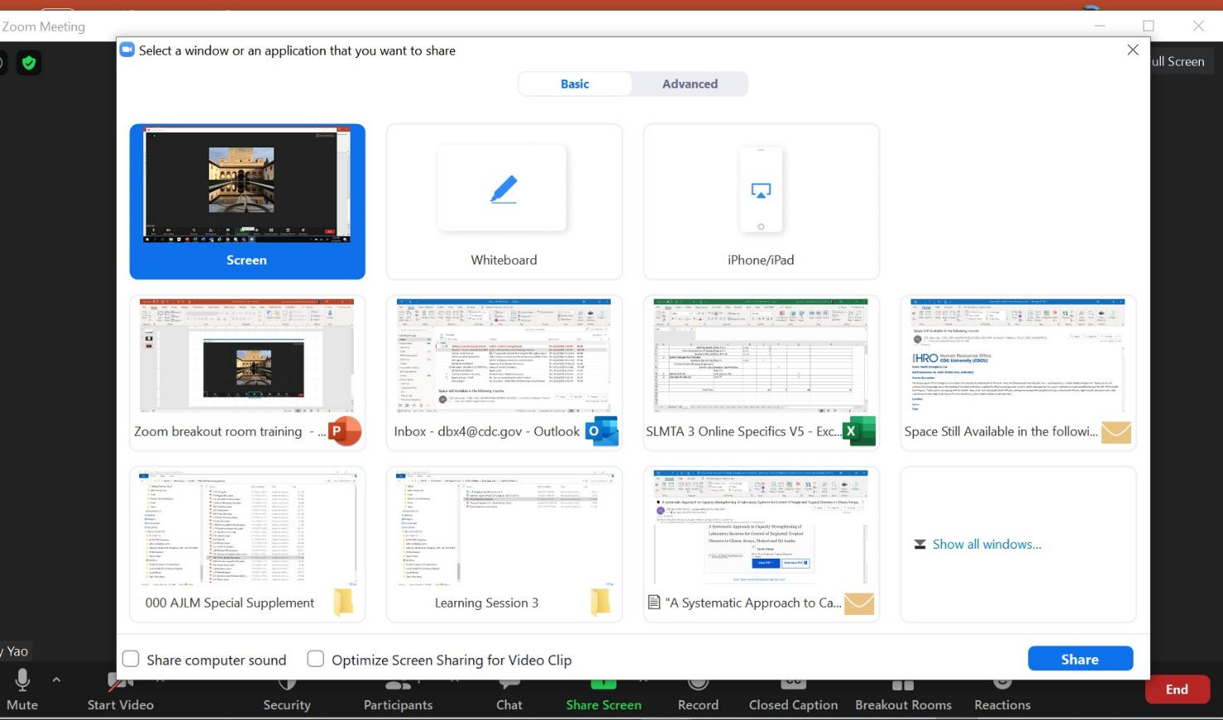
Step 2 – Select Screen or PowerPoint
Step 3 – Click Share

Slide 43
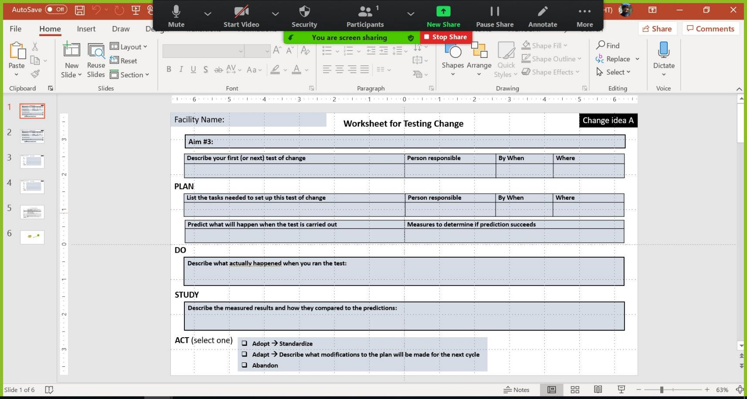
Step 4 – Check the top of your screen to confirm

Slide 44
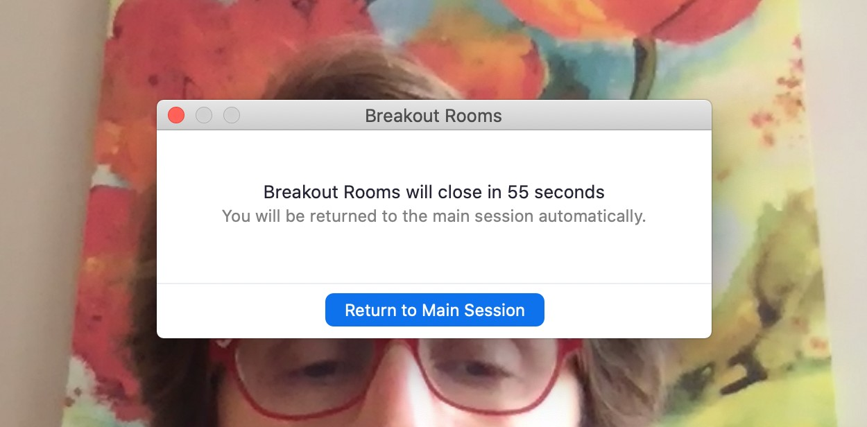
Click Here

Slide 45


. .,
Q Breakout Room 4 Zoom Meeting
)
Talking:
Remaining: 00:29:12
Meeting Topic:
LARC Coaches LS3 Planning Mee
Host:
Kudzai Goredema
Breakout Room:
Breakout Room 4
Passcode:
452848
Participant ID:
432064
Q
•
Join Audio
Share Screen
Computer Audio Connected

Slide 46
Accept
Accept Zoom Breakout Room Invitation – Click on “Join Breakout Room”
Upon arrival in Breakout Room
Click on Participant List
Unmute your Microphone
Room
Zoom Breakout Rooms
In Breakout Room
Coach to facilitate
Objective: Given an assigned challenge, brainstorm a list of CHANGES.
Record CHANGES on Template
Room
Return
Return to Main Zoom meeting
Coach prepared to share screen with list of CHANGES

Slide 47
Deliverable: Link Inputs to
CHANGES to Test

Slide 48
Process Map – Opportunities for Improvement (OFI)
CHANGES to Test
Voice of Customer (VOC)
Root Cause Analysis (RCA)

Slide 49
Process Map – Opportunities for Improvement (OFI*)
CHANGES to Test
1.
2.
3.
Voice of Customer (VOC)
1.
2.
3.
Root Cause Analysis (RCA)
1.
2.
3.
*OFI = Challenges, Problems, Gaps

Slide 50

“If I had an hour to solve a problem…
I'd spend 55 minutes thinking about
the problem and five minutes thinking about solutions.”
Albert Einstein

Slide 51
Facility Name:
CHANGES to Test
A.
Process Map – Opportunities for Improvement (OFI)
1.
2.
3.
Voice of Customer (VOC)
1.
2.
3.
B.
Root Cause Analysis (RCA)
1.
2.
3.

Slide 52
Facility Name:
A. Redesign clinic patient processes, i.e., Client appointment process
CHANGES to Test
Signage is unclear
Patient has to walk around
the clinic to find test results
Next appointment is not written in client’s appointment book
Process Map – Opportunities for Improvement (OFI)
Complaints about long waiting time
Clinic appointment takes the
entire morning and client cannot get to work
3.
Voice of Customer (VOC)
B. Early morning or Saturday clinics
Root Cause Analysis (RCA)
Clinic process is not patient/client friendly
Lab results are taking too
long to get back to the clinic 3.

Slide 53
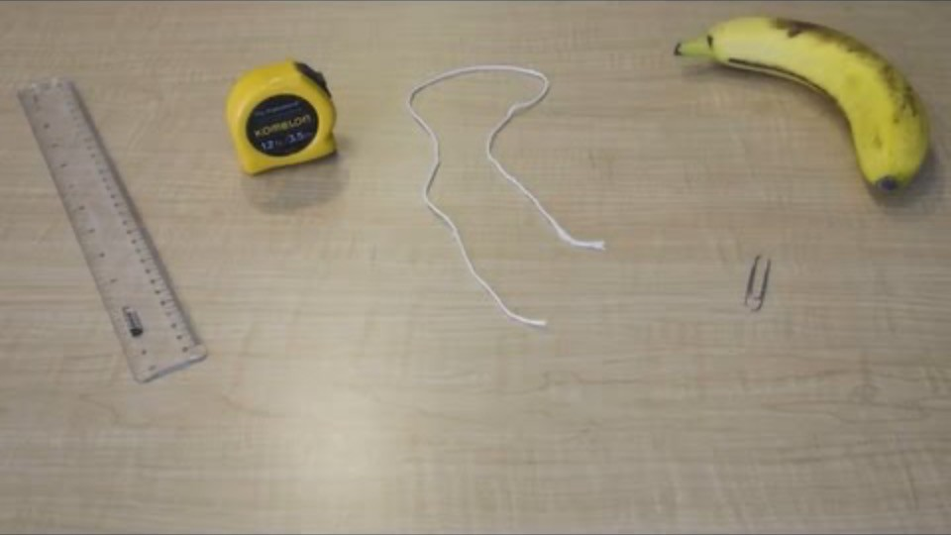

Slide 54
Breakout Room
Measure the Banana Activity
Determine how to measure the banana
Write & record instructions for measuring the banana
Measure the Banana, recording the Answer on a separate slide
Outputs:
q Measurement Instructions
q The Answer for the banana measurement

Slide 55

Facility Name:
Activity:
How to Measure a Banana
1.
2.
3.
4.
5. Etc., for as many steps as you need

Slide 56
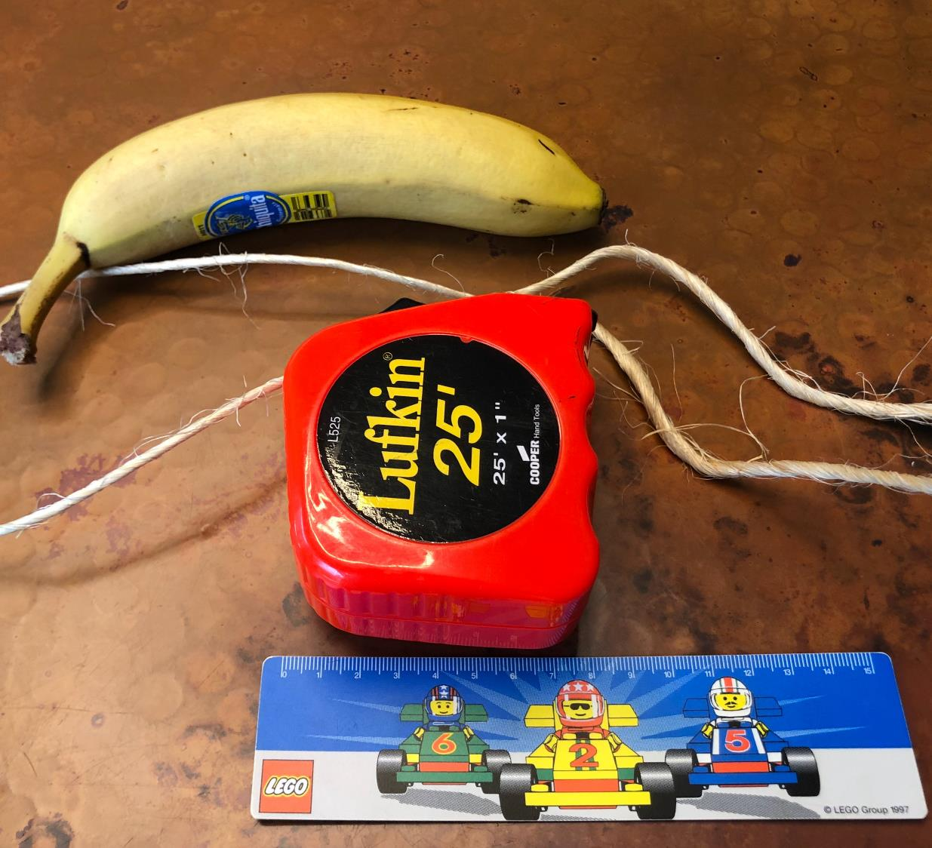
Our measurement (answer) is:

Slide 57
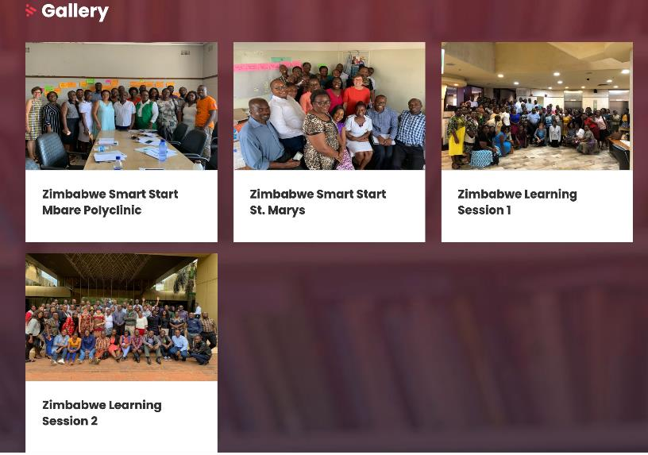
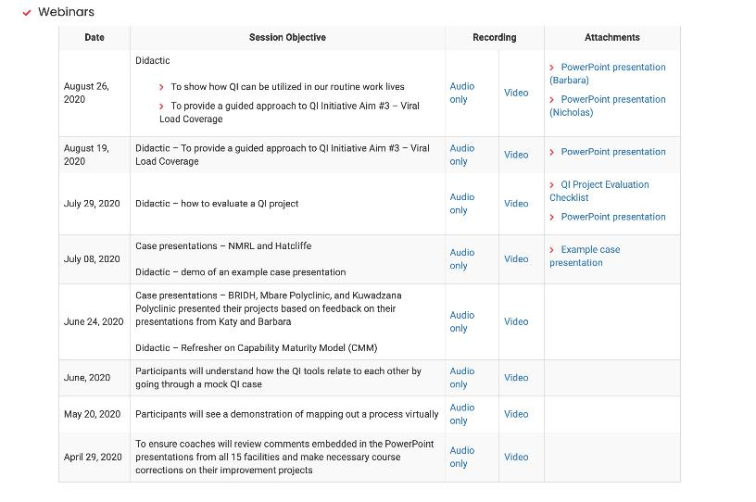
Missed a Meeting?
Check out the recorded sessions on the LARC Website:
https://www.larccqi.org/impl ementations/zimbabwe

Slide 58

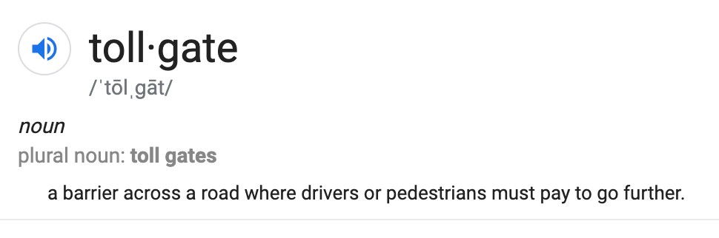
The Six Sigma DMAIC problem solving methodology is accomplished in five phases, or steps: Define, Measure, Analyze, Improve and Control. Between each phase or step many companies employ a “tollgate” to control the
process. Only when the person leading the project confirms that the team has successfully completed the previous phase may they pass the tollgate and move to the next phase.

Slide 59

CHANGE IDEAS
CHALLE NGE

Slide 60

Thank You
Please take the poll!

